Slide 1

SolMan 7.2 Adapter
By Mandy (xin-yuanc@hpe.com)

Slide 2
SAP Solution Manager - SolMan
Product Goal: Manage the SAP solution
Features:
Implementing and Upgrading SAP Solutions
Solution Monitoring
Services and Support
Service Desk
Change Management
Notes:
SAP Solution Manager provides an extensive set of features in the IT Support area for enhancing, automating and improving the management of SAP systems:
Central System Administration
Project Management
Test Management
System Monitoring
Business Process Monitoring
IT Technical Reporting
Centralized Alerting
Installation Keys
Early Watch Reporting
Change Management (Change Request Management & Maintenance Optimizer)
Service Desk (over time was changed to Incident Management) over CRM UI
Central access to tools, methods and preconfigured contents which you can use during evaluation, implementation and operational processing of your systems.

Slide 3
SolMan Adapter – EI – Enterprise Integration
Extension of ALM to integrate SAP Solution Manager with HPE ALM (formerly HP QC)
Main Feature: Synchronize Solution/Blueprint to ALM requirement module, test result, test case and defect
ALM | SolMan 7.1 | SolMan 7.2
Before ALM 12.53 | Yes | No (DB change in 12.50) | NA
ALM 12.53 Patch 1 | Yes | SP03 | SQL Server
ALM 12.53 Patch 2 +Hotfix | Yes | SP04 and SP05 without Site | SQL Server And Oracle
ALM 12.55 | Yes | SP04 and SP05 without Site
ALM 14 OnPrem | Yes | Planned to Support SP06
Notes:
Doc of SolMan 7.2: https://websmp108.sap-ag.de/~form/handler?_APP=00200682500000002672&_EVENT=DISPLAY&_SCENARIO=01100035870000000122&_HIER_KEY=501100035870000015092&_HIER_KEY=601100035870000179416&_HIER_KEY=601100035870000179443&_HIER_KEY=701200252311000003762&
Doc of EI: http://almhelp.saas.hp.com/en/12.53/online_help/Content/EI_User/EI_User.htm
http://alm-help.saas.hpe.com/en/12.53/pdfs/EI_UserGuide_for_SolutionManager72.pdf
ALM release https://softwaresupport.hpe.com/group/softwaresupport/search-result/-/facetsearch/document/KM02741290?lang=en&cc=us&hpappid=202392_SSO_PRO_HPE
Hotfix released on Crypt: https://patch-central.corp.hpecorp.net/crypt-web/protected/viewContent.do?patchId=HOTFIX_TDQC_SAAS_ADD-ON_12.53_2017-04-27_1&product=crypt%3Atdqc%3A&hasProdBreadcrumb=true

Slide 4
SolMan 7.1
One SolMan project associates with one ALM project
Projects are independent with each other
Notes:
In 7.1 each SOLAR projects will be associated to a different HP ALM projects. There will be 1;1 relationship between Solution Manager and 3PTM projects
A new transaction – SLAN which will be used to access Solution Landscape which has details on System and Process Information.
System Landscape has the details on all the logical components assigned and customers can easily add/remove them.
The Business Blueprint is now called Solution Documentation which will provide 2 major sections

Slide 5
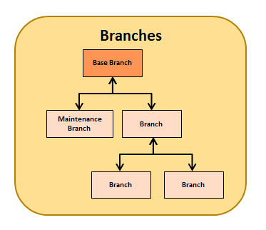
SolMan 7.2
One SolDoc branch associates with one ALM project
The relationship between branches is kept between correspondingly associated ALM projects
Notes:
All the SOLAR projects those were created in 7.1 would be migrated to a single Solution in SMUD. This migration will be carried out by SMUD colleagues.
the dual concept of solutions and projects is replaced by a new Solution Documentation model, based on a hierarchical structure, which uses a new unified solution concept as the single,
central point of access for all Solution Documentation content.
Associate each branch 1 to 1 with alm project, and store the parent and child relationship

Slide 6
Solution
Base Branch
Libraries
Executables
Logical component
ACH hierarchy (multiple levels)
Executables (Test Objects in HP ALM)
Process Steps
Hierarchy (multiple levels e.g. Logical components)
Process Step
Documents (Business Requirement in HP ALM)
Executables (Test Objects in HP ALM)
Business Processes
Hierarchy (multi-level)
Scenario
Documents (Business Requirement in HP ALM)
Executables (Test Object)
Process
Documents (Business Requirement in HP ALM)
Executables (Test Object)
Process Step
Documents (Business Requirement in HP ALM)
Executables (Test Object)
Notes:
The Business Blueprint is now called Solution Documentation which will provide 2 major sections:
Library - This contains sections for Executables, Process Steps, Devlopments and Interfaces. Each section can have many levels of nested folders.
Business Processes - which contains Business Scenarios and Business Processes which are composed out of Process Steps defined in the Library. This section can contain many levels of nested folders ending with Business Scenario, Business Processes and Process Steps.

Slide 7
Basic flow
Migration from SolMan 7.1 to SolMan 7.2 (Content Activation)
Setup & Configuration
Associate Base & Child ALM project with Branch in Solution Documentation
4. Push Solution Documentation to corresponding ALM project
5. Update test result with linked defect
6. Sync defect status
Merge and Sync (Test Repository update)
BPCA – Business Process Change Analysis – Create test set (single mode)
Notes:
In Solution Manager 7.2 SP03, the adapter expects SAML to be configured. This is Mandatory otherwise the incoming calls are prohibited

Slide 8
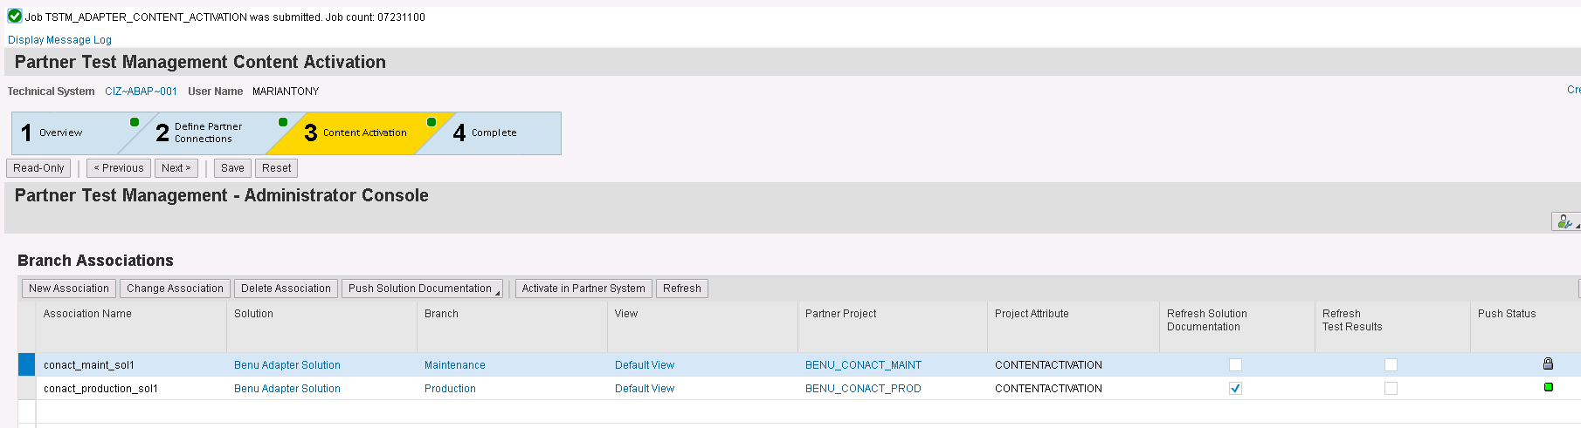
1. Migration – Content Activation
Operation outline:
Setup Solution Manager 7.1 SP14
Setup HP ALM 12.50 or later
Association the SOLAR projects to HP ALM Project, Push the blueprint
Apply notes and finish Content Activation Preparation in SAP Solution Manager 7.1 according to guide doc
Upgrade the Solution Manager system to 7.2 SP03 or later
Run the Solution Documentation Content Activation (GP1 and GP2)
Setup the new Partner Adapter & do an association with ALM upgraded to ALM 12.53 Patch 1 or later
Test the Adapter Content Activation (GP3)
Notes:
GP – Guide procedure
Doc: https://websmp203.sap-ag.de/~sapidb/012002523100011391702015E/ActivationGuide_SolMan72.pdf page 6, 36
One note: https://launchpad.support.sap.com/#notes/2329832

Slide 9
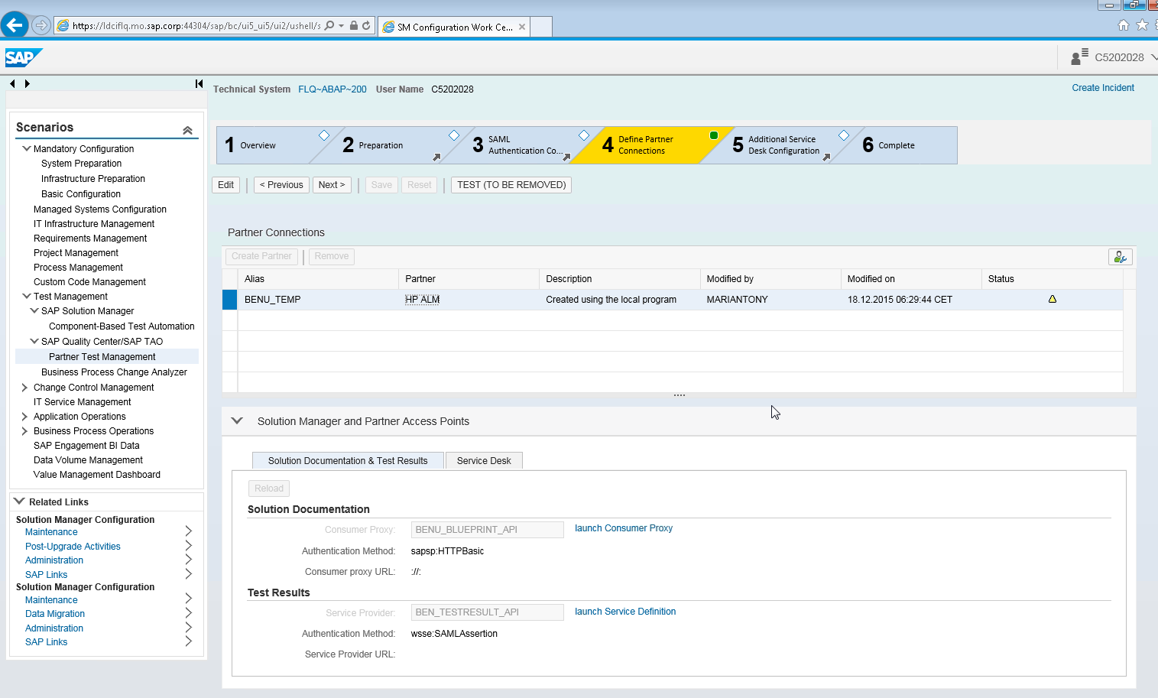
2. Configuration – solman_setup
Trust Certificate
Configure SAML
Create Partner Connection
Adapter SAML Configurations http://scn.sap.com/docs/DOC-75247
Adapter Setup Guide http://scn.sap.com/docs/DOC-75248
Notes:
Certificate, SAML, Create Partner Connection, Define logical port and service binding
Link change to https://www.sap.com/documents/2016/09/8493d979-8b7c-0010-82c7-eda71af511fa.html

Slide 10
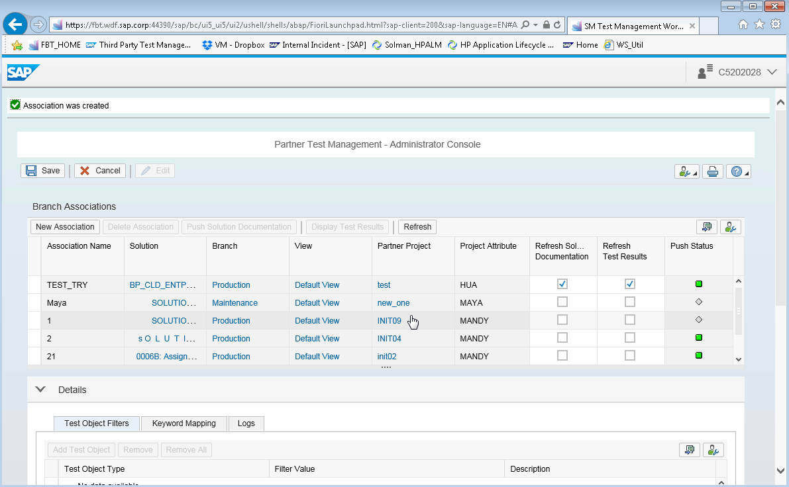
3. Association sm_workcenter > Test Suite > Partner Test Management (PTM)
Notes:
If no test object filter added, the whole hierarchy will be sent to ALM
If some test object filters added, will only sent those ADDed object type to ALM
The keywords needs to be created in the Maintenance view TKEYEPR. (in the transaction SM30 >> Maintain)

Slide 11
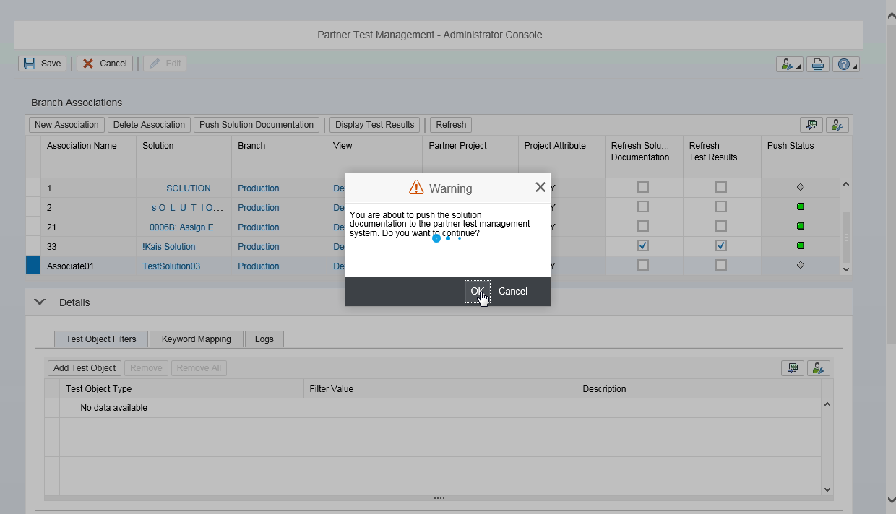
4. Synchronize Solution Documentation to Requirement
Test Object Filter
Keyword Mapping
Log
Update nodes and push again
Keep linkage
Notes:
If no test object filter added, the whole hierarchy will be sent to ALM
If some test object filters added, will only sent those ADDed object type to ALM
The keywords needs to be created in the Maintenance view TKEYEPR. (in the transaction SM30 >> Maintain)

Slide 12
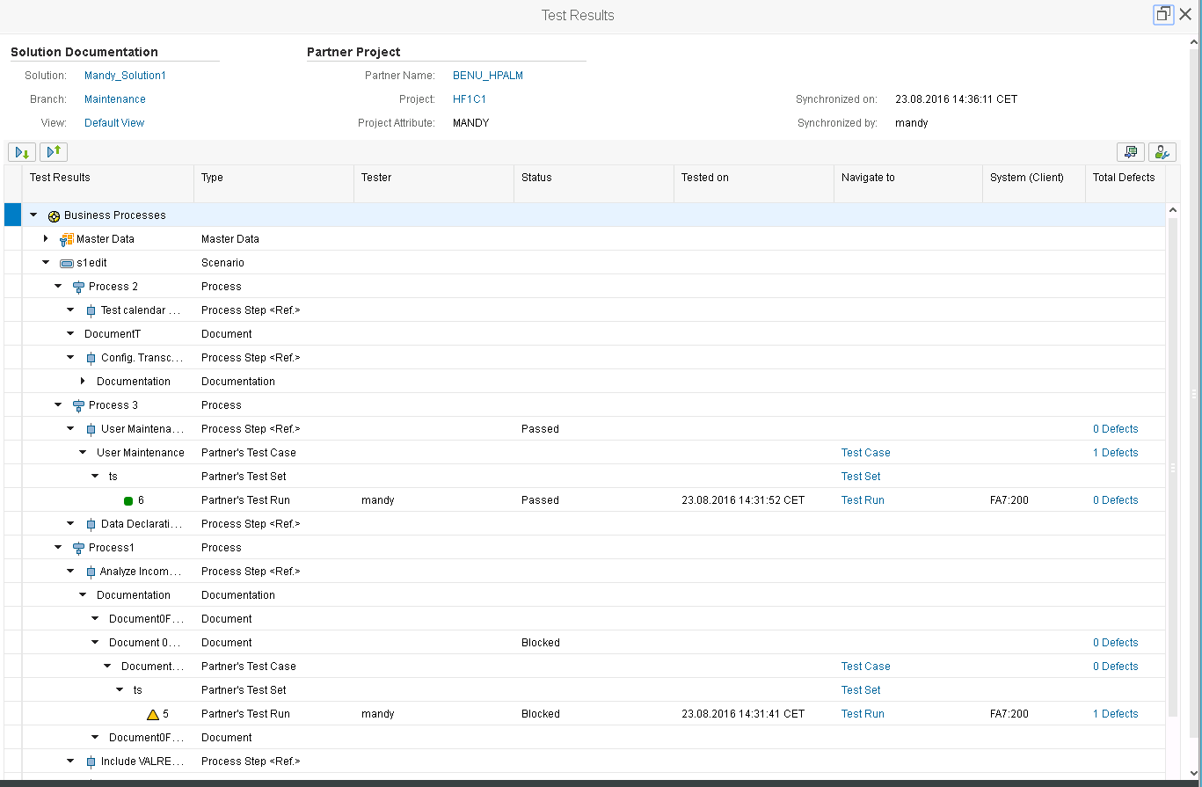
5. Update test result with linked defect

Slide 13
6. Sync defect status
Action | Details Status in CRM | External Help Desk - Interface Status in CRM | Status in ALM | Responsible System in ALM
Create a defect in ALM | Forwarded | In External Processing | New | Quality Center
Assign responsibility to CRM | Received from HPQC | In Internal Processing | /(No change) | Quality Center -> Solution Manager
Request responsibility in CRM | In Process | In Internal Processing | /(No change) | Quality Center -> Solution Manager
Propose Solution in CRM | Proposed Solution | Proposed Solution Sent | Fixed | Solution Manager -> Quality Center
Close defect in ALM | Confirmed (will be Closed in 7.2) | Closed | Closed | /(No change) Quality Center
Reopen or Open in ALM (will create a new incident in CRM) | Forwarded | In External Processing | Reopen / Open | /(No change) Quality Center
Reject in ALM | /(No change) | /(No change) | Rejected | /(No change)
Change status to fixed in ALM | /(No change) | /(No change) | Fixed | /(No change) Quality Center
Forward to External Service Desk(ALM) in CRM / Request responsibility in ALM | Forwarded | In External Processing | /(No change) | Solution Manager -> Quality Center
Field Mapping
Sync
Assign responsibility
Propose solution
Close

Slide 14
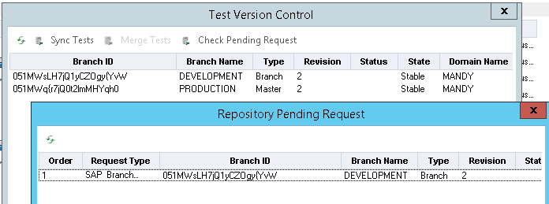
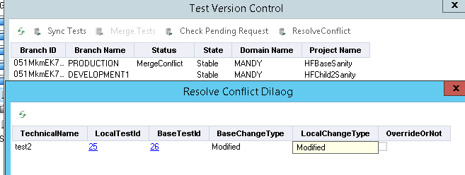
7. Merge and Sync
Merge: copy tests from child project(src) to master project(dest)
Sync: copy tests from master project(src) to child project(dest)

Slide 15
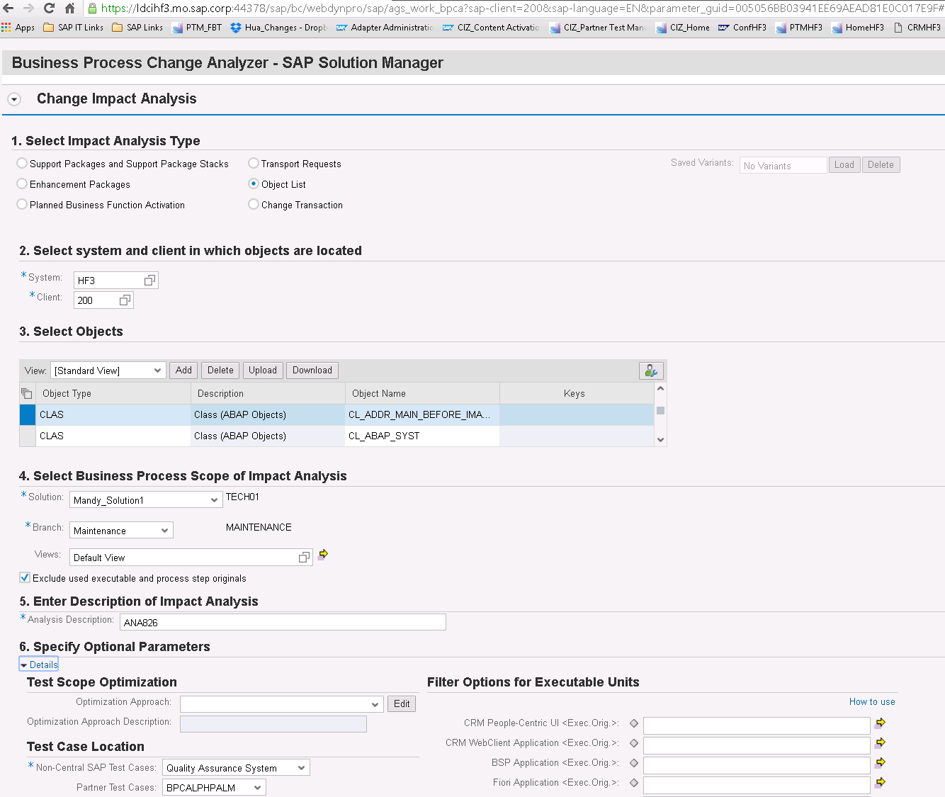
8. BPCA
Create TBOM on executables
Run BPCA
Create Test Plan
Extend Test Plan
Optimize mode
Notes:
New BPCA API for SolMan 7.2 : AGS_BPCA_3PTM_API_72 (in EIServer)
Suggest to set all ref object to “test case assignment type” Additive

Slide 16
Process of Validation team in SAP for Migration
Operation | Status
Setup Solution Manager 7.1 SP14 | Yes
Setup HP ALM 12.50 | Yes
Association the SOLAR projects to HP ALM Project | Yes
Push the blueprint | Yes
Upgrade the Solution Manager system to 7.2 SP03 | Yes
Run the Solution Documentation Content Activation (GP1 and GP2) | It will be done by Today
Setup the new Adapter & do an association | No
Test the Adapter Content Activation (GP3) | No
To do this we need HP ALM 12.53 Patch 1
Notes:
Process of Validation team in SAP

Slide 17
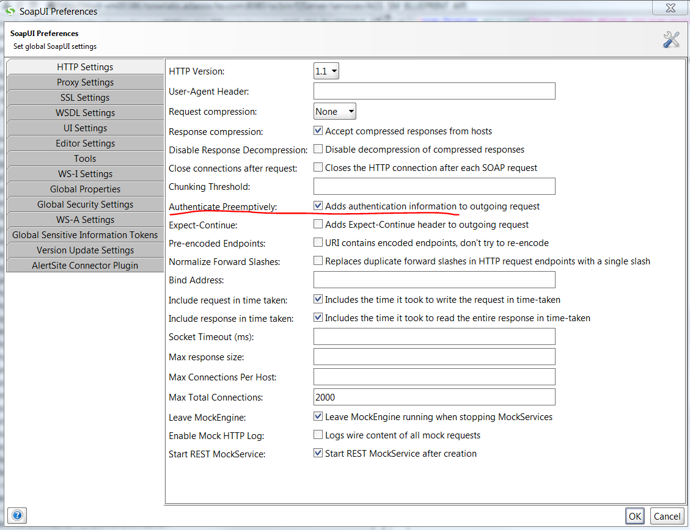
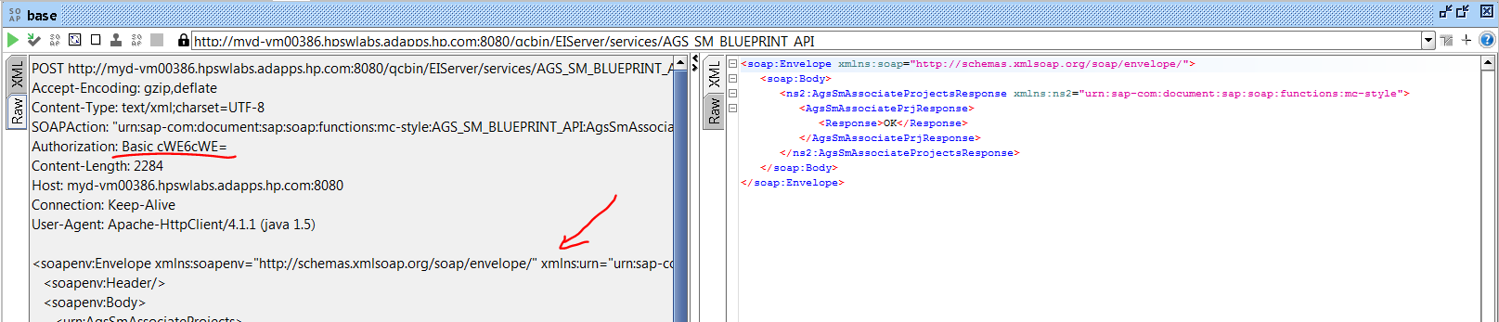
If still no authentication in raw, save all and restart soapui
Notes:
Test the API by SoapUI

Slide 18
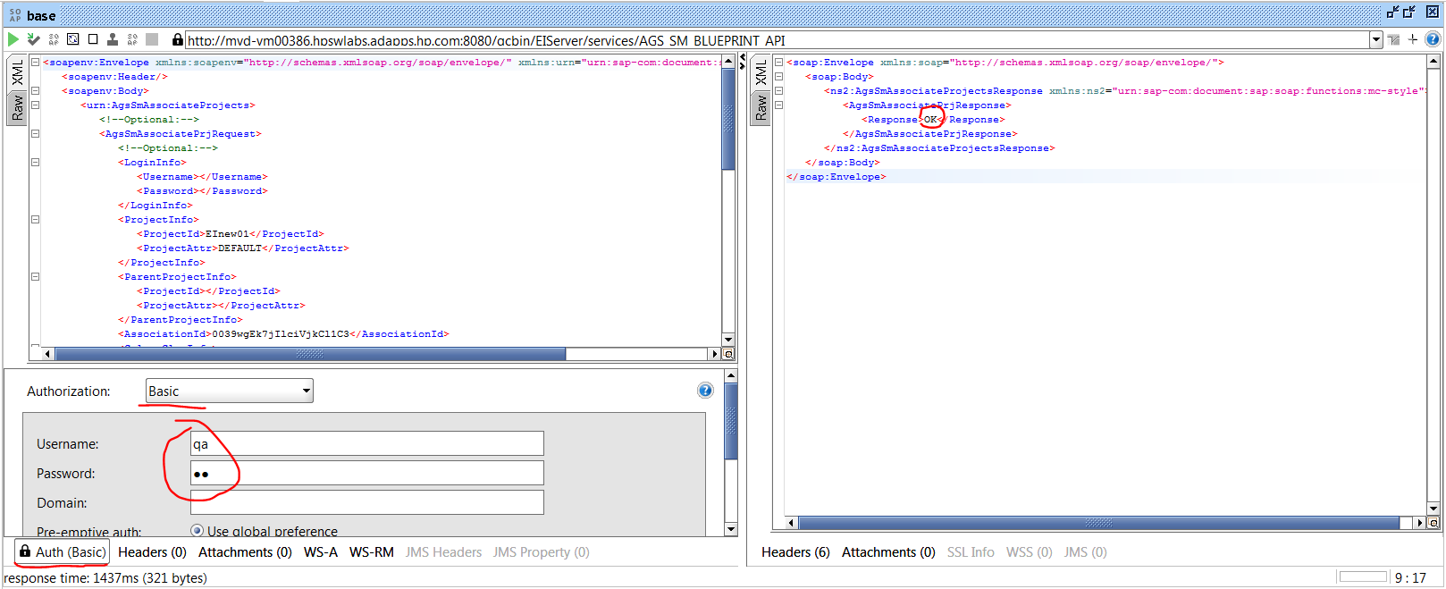
Associate base project

Slide 19
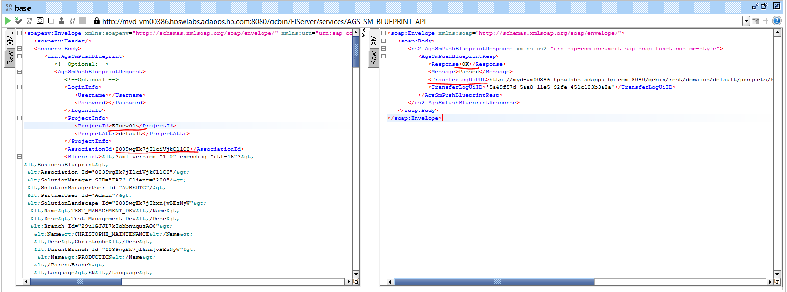
Push base blueprint, then add linkage manually

Slide 20
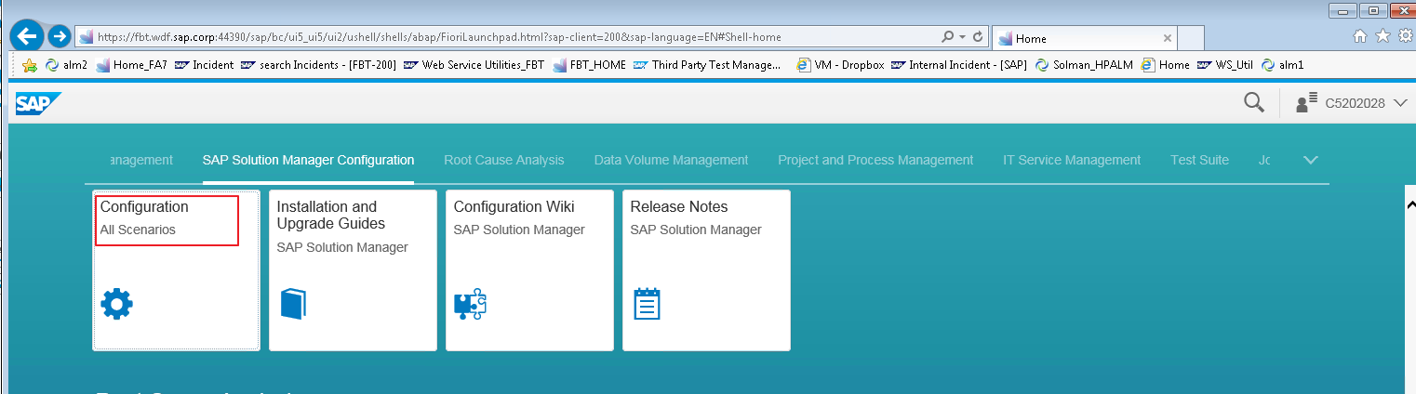
Configuration in SolMan 7.2 : SOLMAN_SETUP
Notes:
Account: Andrew C5202028 W3lcome6 123234 220225936
Transaction: SOLMAN_SETUP
Refer to Partner Test Management - Setup Guide.pdf
(720_SP03_3PTM_001.doc and 720_SP03_3PTM_016.doc)
https://fbt.wdf.sap.corp:44390/sap/bc/webdynpro/sap/wd_sise_main_app?sap-language=EN#

Slide 21
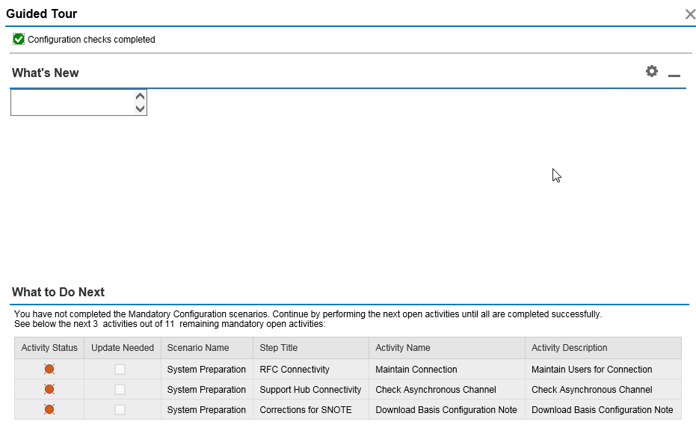

Slide 22
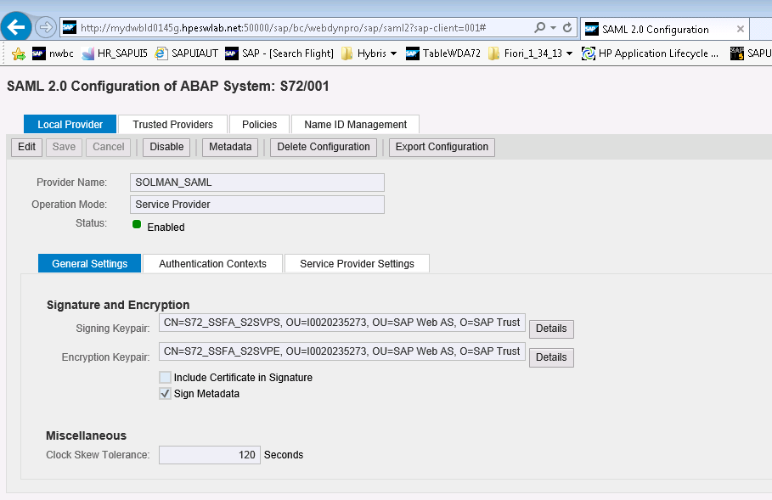
SAML2

Slide 23
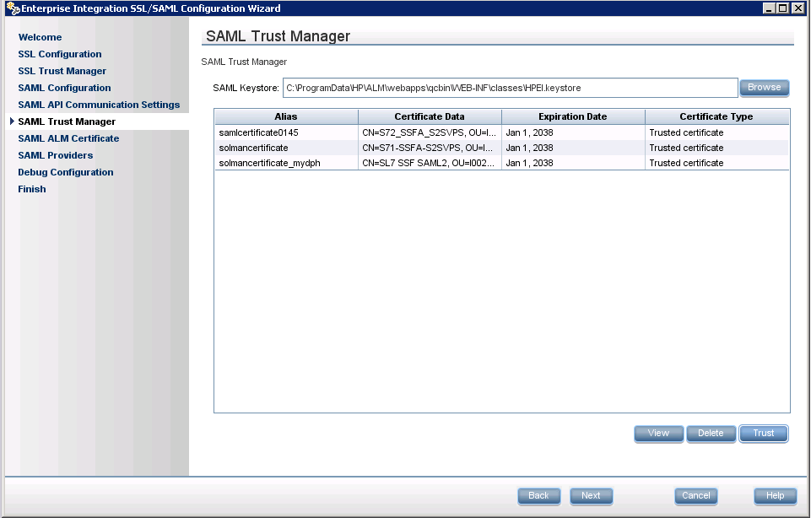

Slide 24
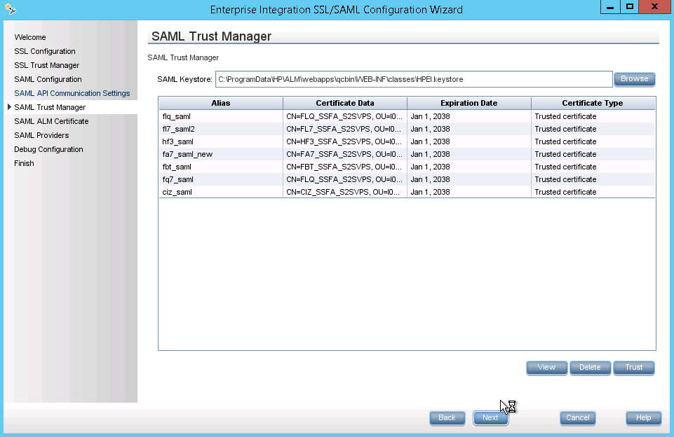
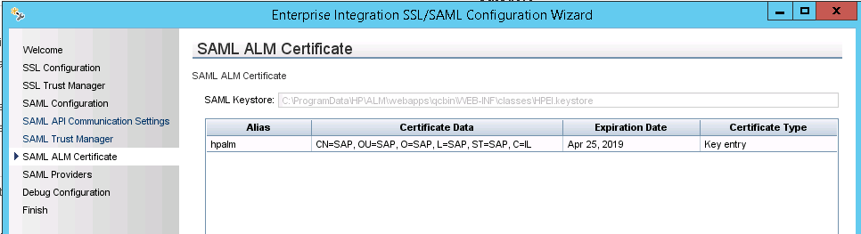
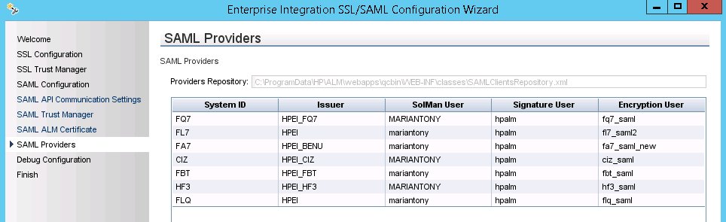

Slide 25
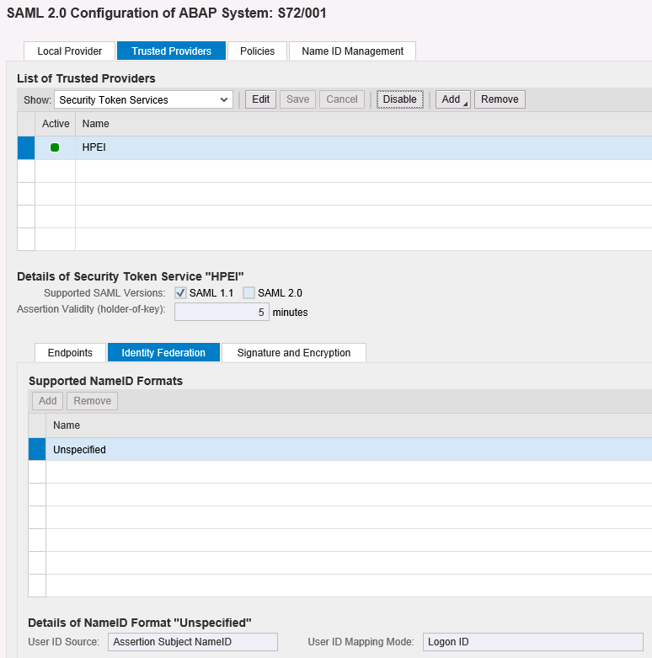

Slide 26
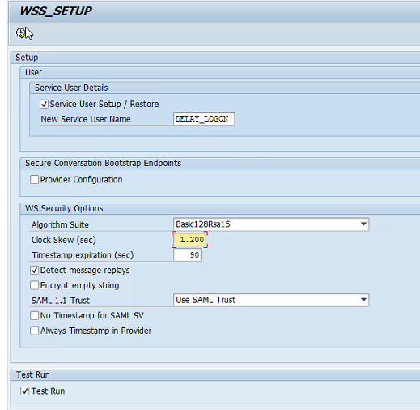
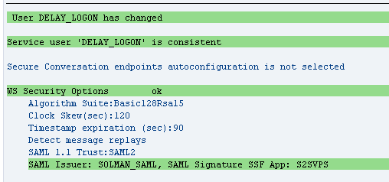
Notes:
se38 wss_setup do not check on “Test Run”

Slide 27
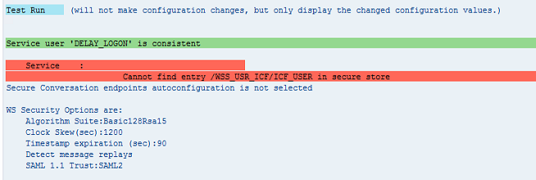
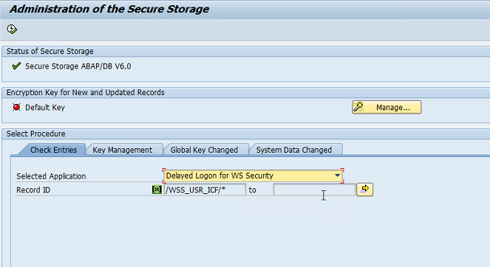
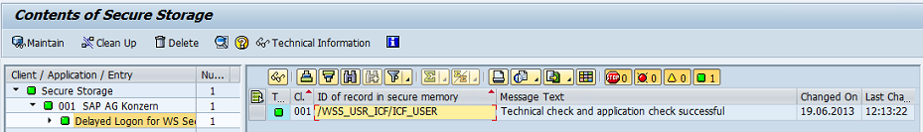
Notes:
Secstore
Delayed Logon for WS Security

Slide 28
Configuration
Notes:
Adapter Setup Guide
http://scn.sap.com/docs/DOC-75248
Adapter SAML Configurations
http://scn.sap.com/docs/DOC-75247
Profile SAP_ALL, if ask to create new user can ignore

Slide 29
Notes:
Partner Test Management - Setup Guide.pdf

Slide 31
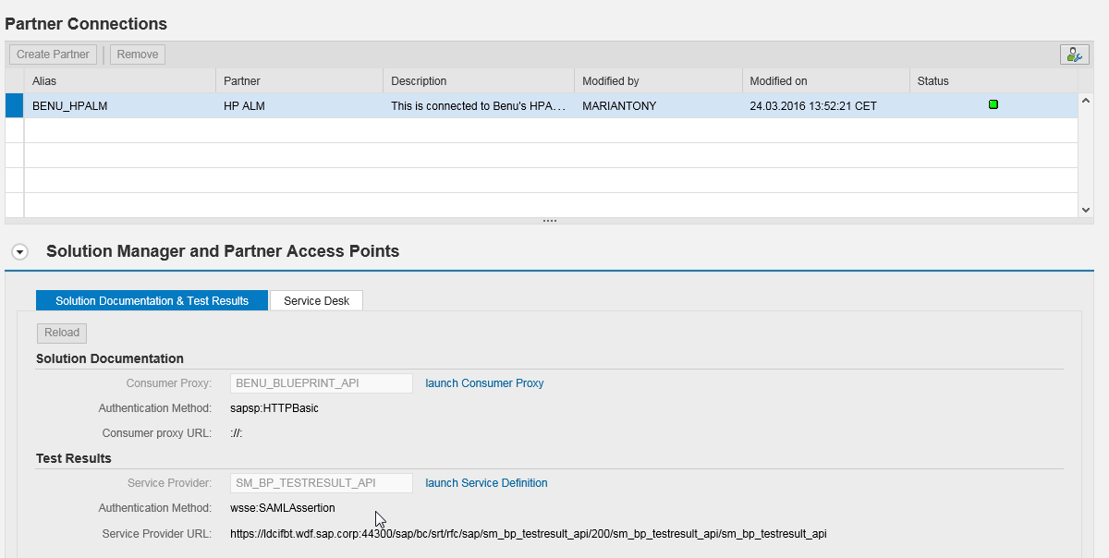
Partner Connection

Slide 32
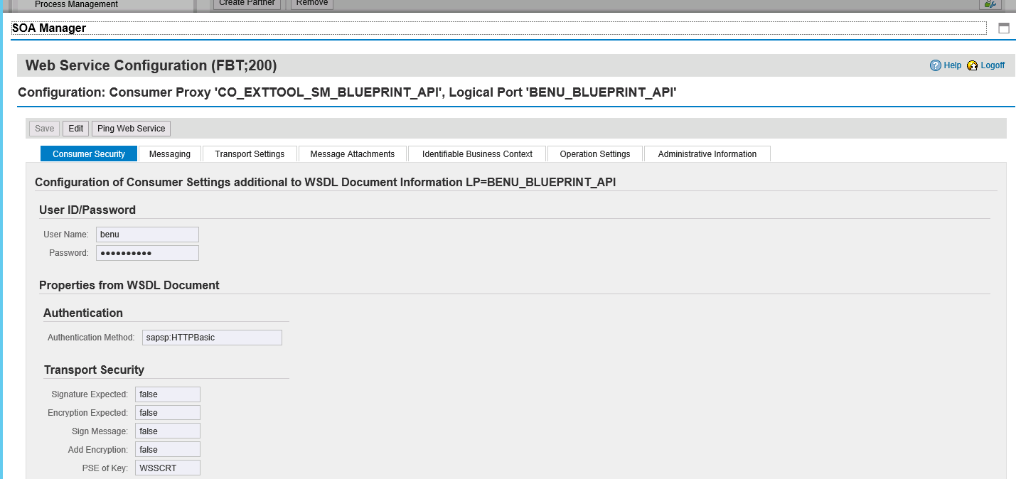

Slide 33
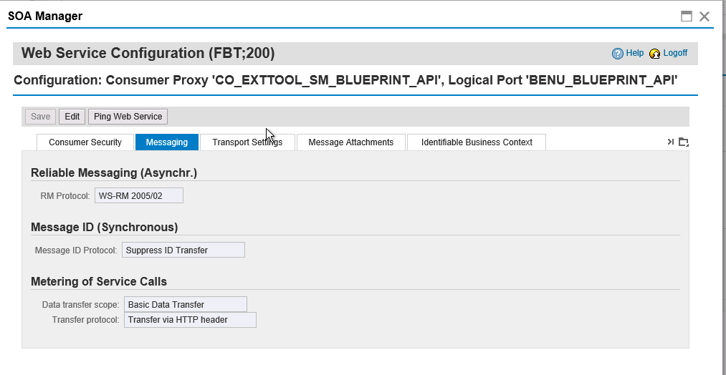

Slide 34
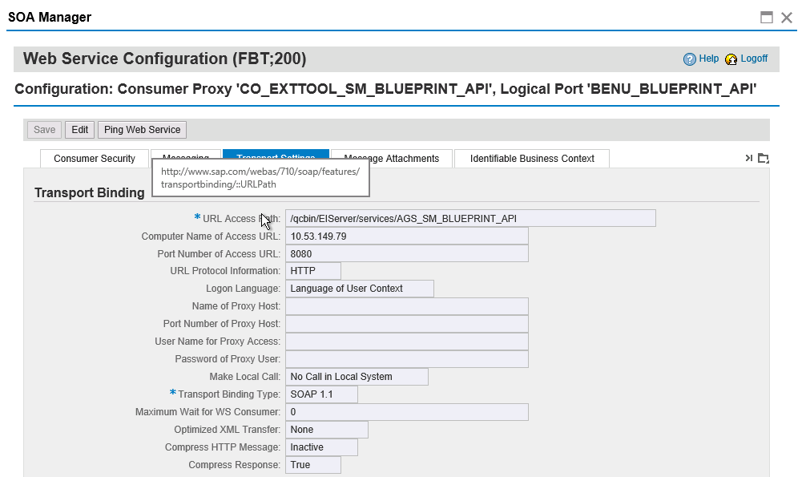

Slide 35
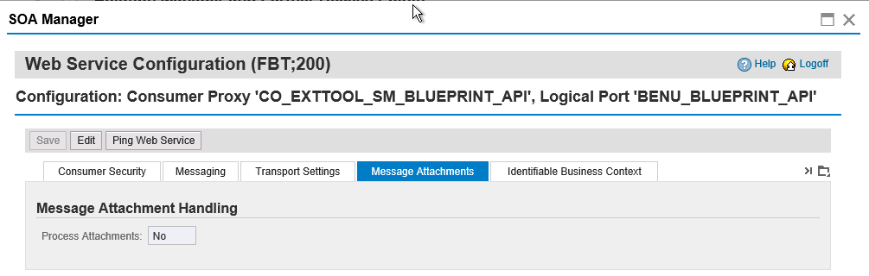
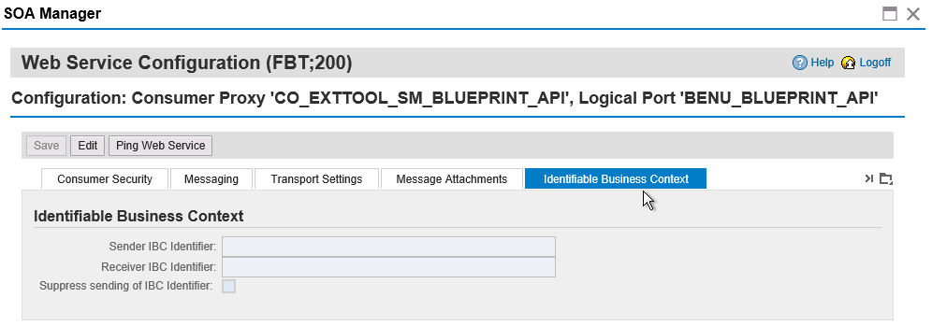

Slide 36
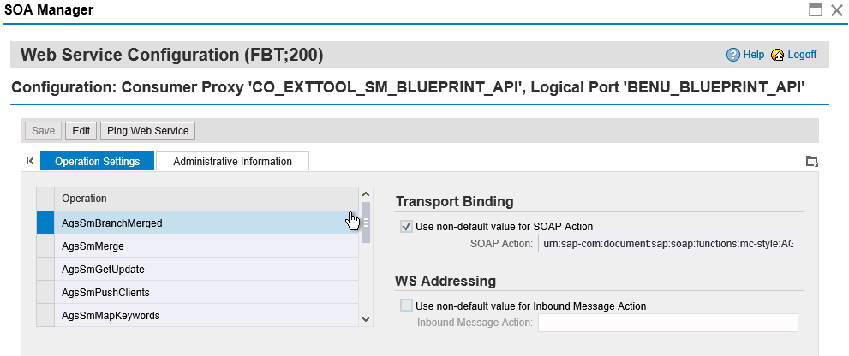

Slide 37
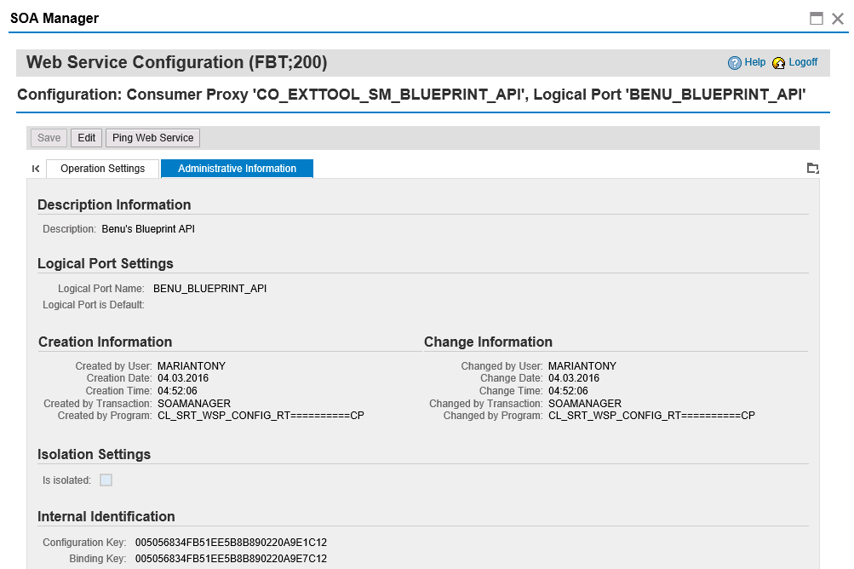

Slide 38
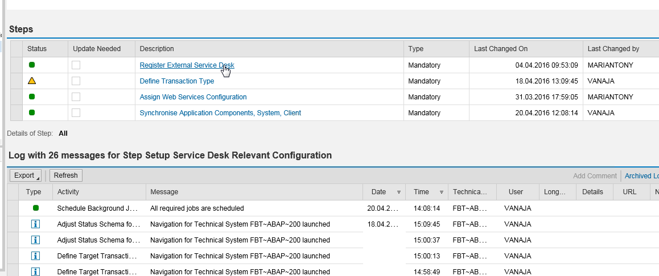

Slide 39
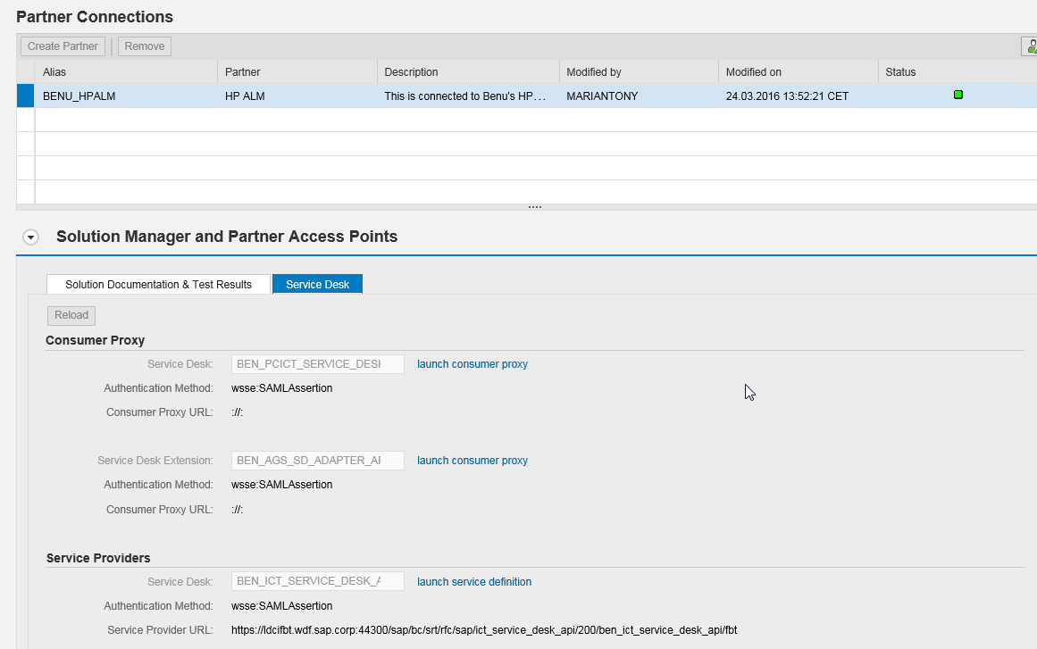

Slide 40
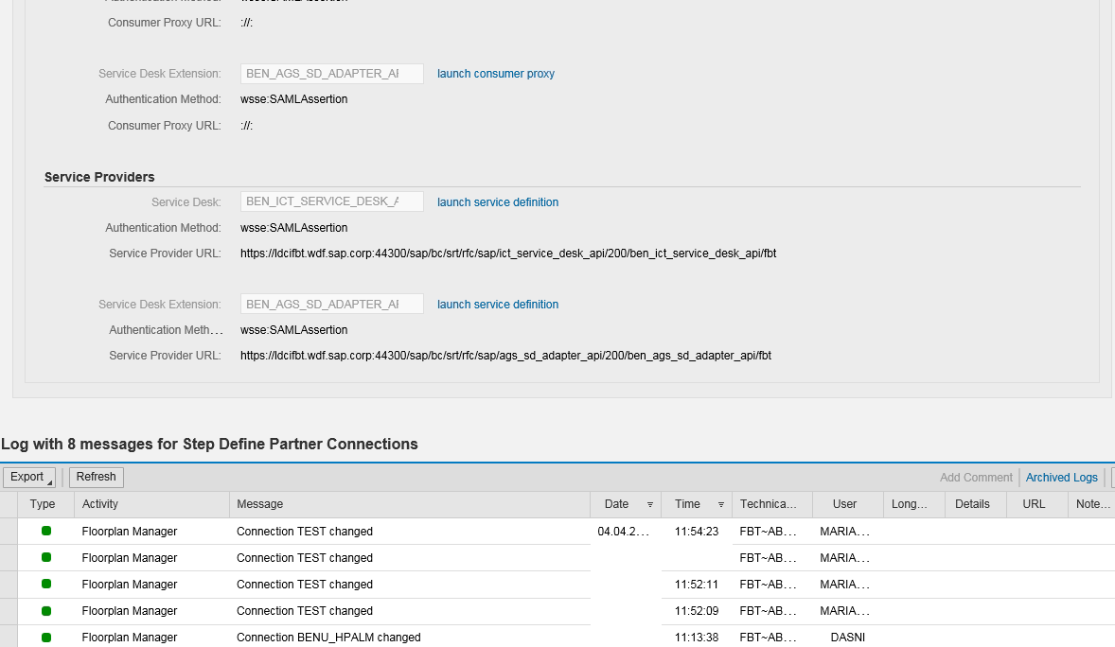

Slide 41
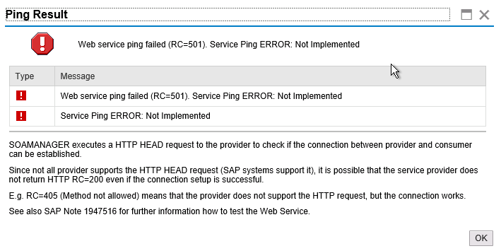

Slide 42
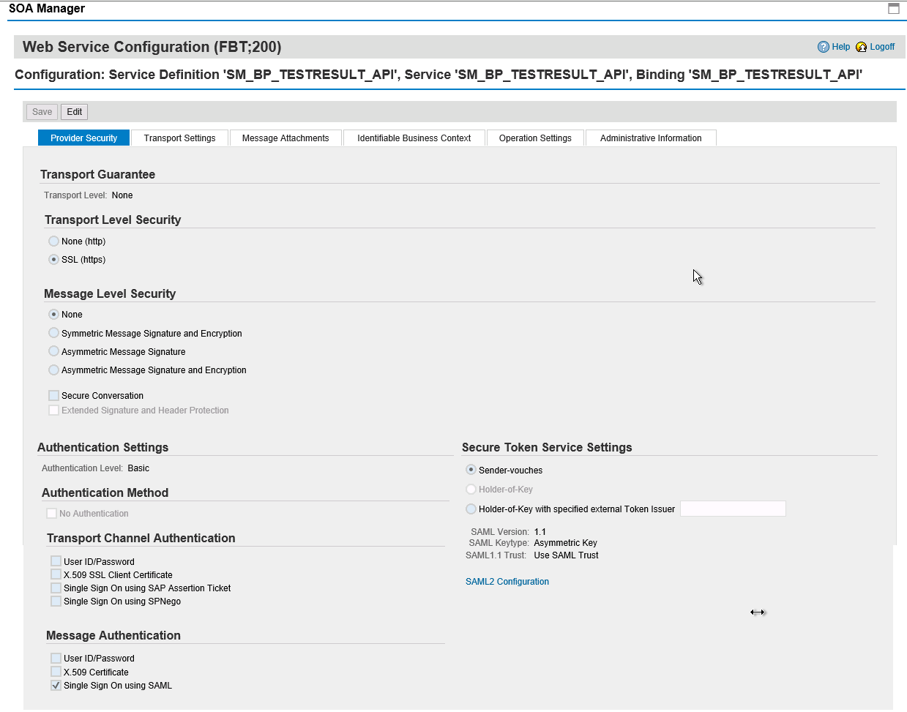

Slide 43
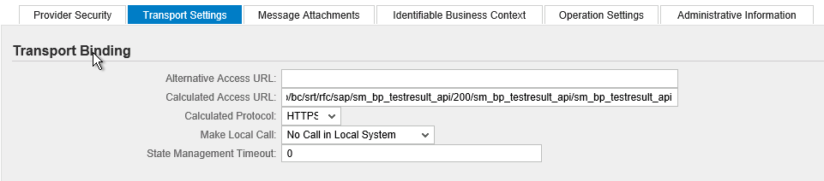
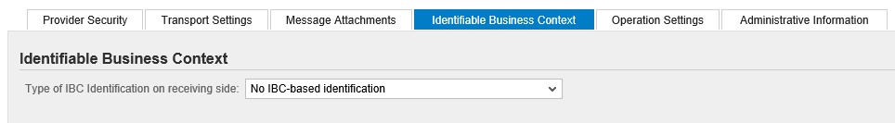
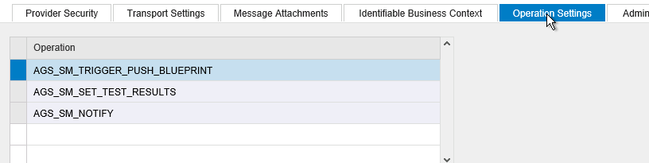

Slide 44
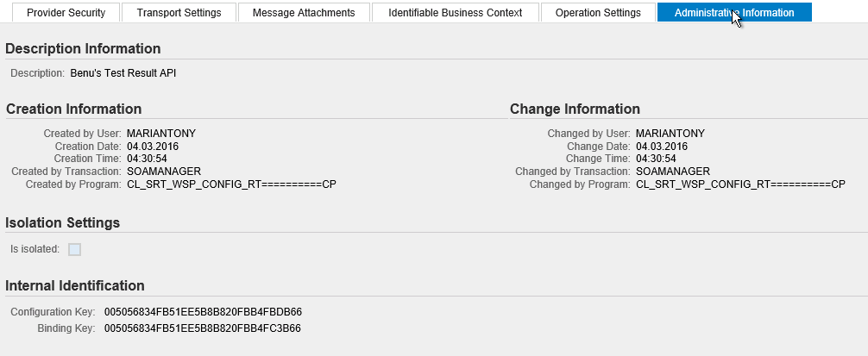

Slide 45
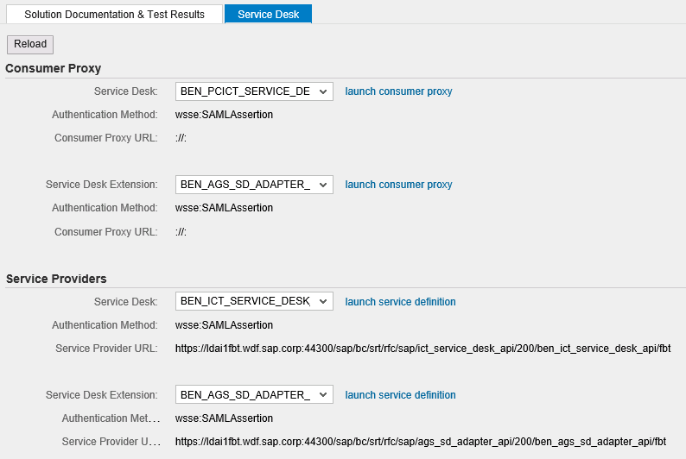
Service Desk

Slide 46
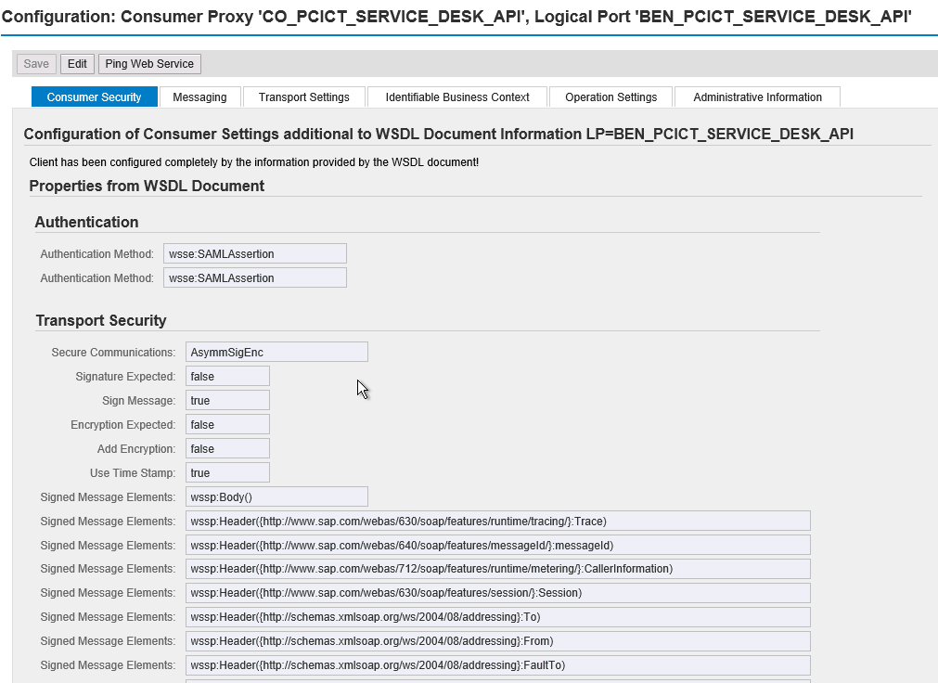

Slide 47
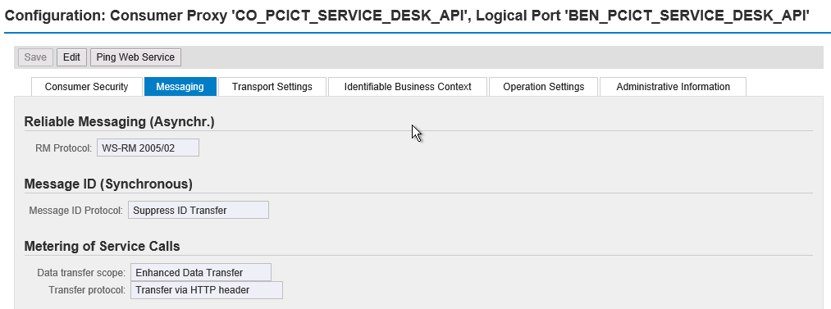
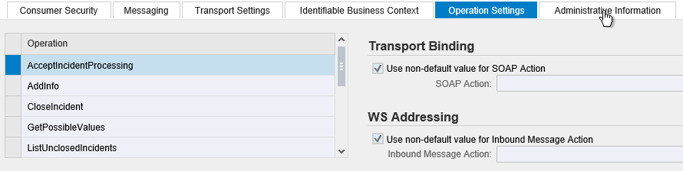

Slide 48
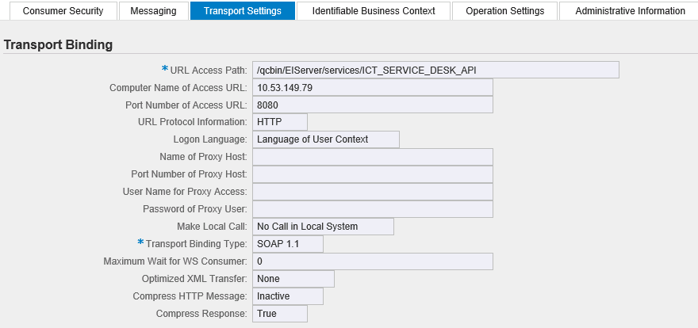

Slide 49
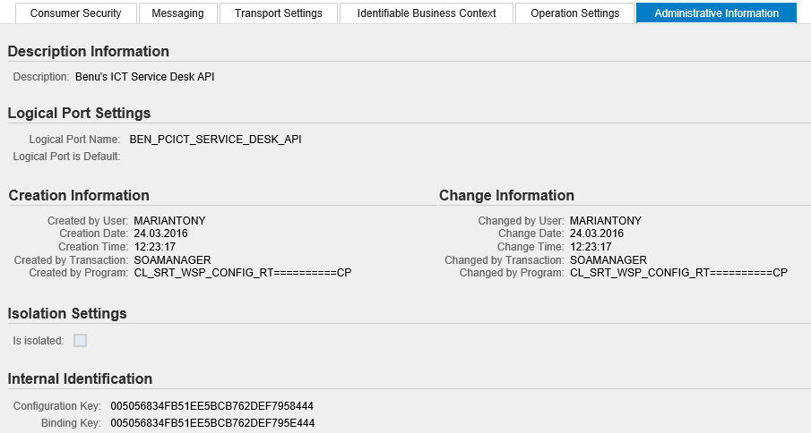

Slide 50
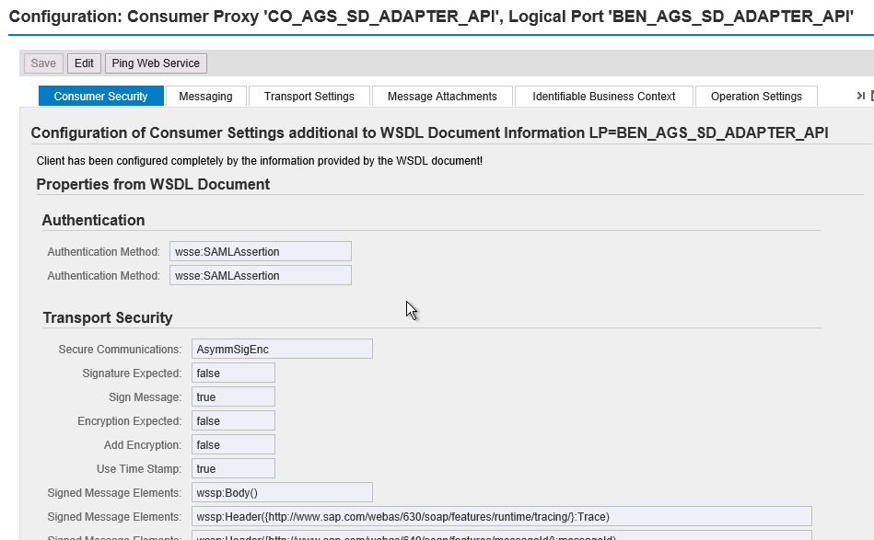

Slide 51


Slide 52



Slide 53


Slide 54




Slide 55


Slide 56




Slide 57

Notes:
ictconf

Slide 58


Active service desk in sicf
Notes:
Active service desk in sicf : ict_service_desk_api
Then add in ictconf and check
Then reassociate project and do field mapping

Slide 59

Notes:
BPCA

Slide 60
Import SolDoc 403 error
issue of “403 error”. The error is solved now. The service “WDC_ADAPTER_ADMIN_CENTER” was not active in SICF transaction.

Slide 61

Notes:
EIServer
New BPCA API for SolMan 7.2 : AGS_BPCA_3PTM_API_72

Slide 62

Notes:
A new Site param ENABLE_EI_SAML_FOR_SOLDOC is added
ENABLE_EI_SAML_FOR_BLUEPRINT will not work anymore (it is for SolMan 7.1)

Slide 63

sm_workcenter -> Test Suite -> Partner Test Management
Notes:
https://fbt.wdf.sap.corp:44390/sap/bc/ui5_ui5/ui2/ushell/shells/abap/FioriLaunchpad.html#Shell-home

Slide 64

Select one solution in Partner Test Management
Notes:
sap/bc/ui5_ui5/ui2/ushell/shells/abap/FioriLaunchpad.html#Action-PartnerTestMangement?STANDALONE_MODE=X&VIEW_ID=THIRD_PARTY
http://mydwbld0145g.hpeswlab.net:50000/sap/bc/ui5_ui5/ui2/ushell/shells/abap/FioriLaunchpad.html?sap-client=001&sap-language=EN#Action-PartnerTestMangement?STANDALONE_MODE=X&VIEW_ID=THIRD_PARTY

Slide 65

SLAN
Notes:
soladm

Slide 66

Create Solution

Slide 67

Create Solution

Slide 68


Slide 69

Add Logical Component Group
Notes:
A logical component can be an attribute of objects. With this information and the system role function, it allows to determine the correct target system, for example the maintenance or development system.
Logical component groups are uniquely defined for each solution. It is not possible to assign a logical component group to several solutions. The unique identifier for a logical component group is the logical component group name. The name is unique for the whole system. This name cannot be changed after the creation of a logical component group.

Slide 70

Assign Technical Systems for D, Q, P System
Notes:
System Role: Intended purpose of a system-client combination (ABAP) or system (Java) within a logical component, for example, Development, Test, or Production. Applications within SAP Solution Manager use the system role to determine which system to use for various operations. For example, an analysis of usage statistics needs to run on a production system.
A logical component is the “branch view” on a logical component group i.e. the subset of systems which belong, for example, to the production, maintenance or development tracks of your solution. Similar to SAP Solution Manager 7.1 a logical component is a vector of technical systems and system roles that usually correspond to a transport track of your landscape

Slide 71

Assign Technical Systems for D, Q, P System
Notes:
Every system has a RFC destination mapped by default. Please use the following systems,
FA7 Client 200
FBT Client 200
SD7 Client 200
SQ7 Client 200
SI7 Client 200 (no RFC)
These systems has the RFC destination configured already

Slide 72

This might be caused by RFC not defined system
Change the technical system assigned to system role, then problem gone

Slide 73

Add Document type in scope

Slide 74


Open Branch

Slide 75

Edit Solution Document

Slide 76

Add Process Steps to Libraries

Slide 77

Add Scenario and Process to Business Processes

Slide 78

Add Process Step to Process

Slide 79


Slide 80

Search in Process Step Library

Slide 81

Search specified object
Notes:
If no object , probably the logical component doesn’t assign with proper system

Slide 82


Specify Executable

Slide 83

Release process step to Production branch
Remember to release library too
Notes:
Notice: it’s mandatory to release both library and the business process
only then the original would be replicated to the parent branches

Slide 84

Release notice

Slide 85

Add Document

Slide 86


Slide 87


Slide 88


Create Association
Notes:
Production Branch need to be associated firstly.
One ALM project associate with one SolMan solution.

Slide 90

Test Object Filter
Notes:
If no test object filter added, the whole hierarchy will be sent to HPQC
If some test object filters added, will only sent those ADDed object type to HPQC

Slide 91


Slide 92
Push Blueprint
Notes:
regarding the buffering issue in Push Solution Documentation.
In case you feel that there is a change in the solution documentation, you need to refresh the Adapter Administration Console to get the latest changes

Slide 93

Multiple View

Slide 94
Async (background mode) process
should be like this:
1. sap send us the blueprint with aync request
2. we reply with push_bP_start
3. we send lock event
4. handle blueprint
5. send unlock event when we done
6. send push_bp_end

Slide 95

Push SolDoc
Notes:
Two modes:
Foreground: Will need to wait it finished before start another push
Background: Async way, can start push simultaneously

Slide 96

Push Log

Slide 97

Need to add dns in hosts for opening log
Add parameter in SiteAdmin: ENTITY_LINK_HOST and ENTITY_LINK_PORT can also solve this problem

Slide 98



Slide 99


Requirement detail
Notes:
Description - > Name
Name -> SM object code
Logical component group of folder is set by default to be the last LCG sent in SolDoc

Slide 100
External link

Slide 101


Check hierarchy in ALM
SM view can be filtered

Slide 102

Edit View

Slide 103

Req hierarchy

Slide 104



Customized process step will be parallel with element in requirement hierarchy

Slide 105



import
Notes:
SAP Tools

Slide 106



Report program to test unique features
Se38 AGS_ADAPTER_MANAGE_ASSOCIATION
AGS_ADAPTER_SOLDOC_SYNC
Notes:
No need to deassociate
One backdoor in SolMan
Can also used to push application component

Slide 107
Async
PUSH_ASYNC_BLUEPRINT_NOTIFY_INTERVAL_IN_SEC
Default: 300 (s)

Slide 108

Libraries in Base project
Notes:
It is for copy test asset, merge and sync
When associate child project, if there is entities in base project, there will be export library in base project and import library in child project.
For each child project of base project, the mapped baseline of export library will be recorded in table Library_used_by in base project
Every time doing merge or sync, the destination project will generate two baseline under the library

Slide 109

Copy project in ALM
Notes:
Choose copied content : Requirements , Users and Groups
But map keyword need to check append manually

Slide 110

Field mapping need to check the “Append”

Slide 111

Copy test from base project to child project
Notes:
Linkage between requirement and test are supposed to be copied
Known limitation: if copied in same folder will cause duplicate when merge/sync

Slide 112

Update Result
Defect Status & Code
CLOSED (1),
FIXED(2),
NEW (3),
OPEN(4),
REJECTED (5),
REOPEN(6)
Test Result Status & Code
BLOCKED (1),
FAILED (2),
N_A (3),
NO_RUN (4),
NOT_COMPLETED(5),
PASSED (6);
Notes:
Linked Defects of Test Execution Result should be added in Test Run instead of Test Lab

Slide 113

Test Result
Notes:
Defect need to link with test execution in test run not in test lab
https://ldcifbt.wdf.sap.corp:44300/sap/bc/webdynpro/sap/WDC_ADAPTER_TEST_RESULTS?sap-client=200&sap-language=EN#

Slide 115


Slide 116


Slide 117


System Role in test set

Slide 118

Keep Linkage
Deleting requirement can choose not to delete linkage, next time when deleted requirement is repushed from SolMan, requirement will be automatically linked with test which it linked before

Slide 119


Relink
Notes:
If after requirement repushed, linkage between test and requirement not recreated, “Relink Tests” can be launched to relinke test with requirement

Slide 120

linkage

Slide 121

Service Desk

Slide 122

Open from crm_ui

Slide 123

Personalize to see external help desk
Notes:
https://ldcihf3.mo.sap.corp:44378/sap(bD1lbiZjPTIwMCZkPW1pbg==)/bc/bsp/sap/crm_ui_start/default.htm

Slide 124






Notes:
When link to multiple requirements or tests, need to set corresponding field in defect

Slide 125


Slide 126
Action | Details Status in CRM | External Help Desk - Interface Status in CRM | Status in ALM | Responsible System in ALM
Create a defect in ALM | Forwarded | In External Processing | New | Quality Center
Assign responsibility to CRM | Received from HPQC | In Internal Processing | /(No change) | Quality Center -> Solution Manager
Request responsibility in CRM | In Process | In Internal Processing | /(No change) | Quality Center -> Solution Manager
Propose Solution in CRM | Proposed Solution | Proposed Solution Sent | Fixed | Solution Manager -> Quality Center
Close defect in ALM | Confirmed (will be Closed in 7.2) | Closed | Closed | /(No change) Quality Center
Reopen or Open in ALM (will create a new incident in CRM) | Forwarded | In External Processing | Reopen / Open | /(No change) Quality Center
Reject in ALM | /(No change) | /(No change) | Rejected | /(No change)
Change status to fixed in ALM | /(No change) | /(No change) | Fixed | /(No change) Quality Center
Forward to External Sercive Desk(ALM) in CRM / Request responsibility in ALM | Forwarded | In External Processing | /(No change) | Solution Manager -> Quality Center
Notes:
Status change in process

Slide 127



Slide 128
7.1 behavior
In SolMan 7.1
In sap side, request responsibility, add description, refresh in Alm ,get updated. (also updated field like sm client, severity)
Click sync, the responsibility will not change

Slide 129

BPCA – Business Process Change Analyzer
Notes:
https://fbt.wdf.sap.corp:44390/sap/bc/webdynpro/sap/ags_work_bpca?sap-client=200&sap-language=EN&parameter_guid=FA163E7FD5661EE697F78B563AAE96AF#
Perform change impact analysis by comparing TBOM (Technical Bill of Material, list the SAP objects that are used when transactions in business process execute)
Integrate with ALM to create regression test plan based on result of BPCA
User can optimize test scope based on test coverage, test efforts and priorities

Slide 130
There are two type:
1. manually create dynamic TBOM for executable
2. static TBOMs
Go to Executable Library to generate TBOM there
Because it is kind of original place of the executables, other place which reference the executables will inherit the TBOMs
It is okay to create TBOM for reference, but we suggest to have TBOMs for all executables, then we are more or less happy
Dynamic TBOM: need to be executed, execute tracing
Static is based on code (static infomation) behind executable

Slide 131
• Dynamic TBOMs – dynamic TBOMs collect only those objects used by a given transaction during the execution. This means the transaction/process step has to be executed either automatically or manually to create dynamic TBOMs. Dynamic TBOMs are more granular and accurate and thus can be used to differentiate process step variants (Ex: Create rush order vs Create standard order using VA01 transaction)
• Semi-Dynamic TBOMs – semi-dynamic TBOMs are created using UPL data (Usage and Procedure Logging) from the production system. It is possible to create these TBOMs from SAP Solution Manager 7.1 SP10. They can be created in a mass fashion using a background job in BPCA. They are accurate as they are based on usage data from production system. But semi-dynamic TBOMs cannot be used to differentiate process step variants.
• Static TBOMs – static TBOMs are created by just going through the source code scan of a given transaction. They have restriction on the number of levels of such a scan. Thus the static TBOMs are prone to be inaccurate as they will contain objects not used by the customer and sometimes might miss out some objects in the deep levels of the code. They are not recommended to be used for productive usage of BPCA.

Slide 132

Dynamic way to create TBOM

Slide 133


Slide 134




Slide 135



Slide 136


Slide 137

Notes:
Record some Object Name in Software Component that is collected in TBOM
CL_ABAP_MESSAGE_DIGEST
CL_ABAP_SYST
CL_ADDR_CHECK
CL_ADDR_MAIN_BEFORE_IMAGE
CL_ABAP_PSE
CL_AGENT_INFO
CL_SYSTEM_UUID
SU01: CL_AGENT_INFO,CL_ADDR_MAP

Slide 138


Slide 139



Slide 140




Slide 141

Notes:
The transaction will be executed automatically, the transaction I chose here is to open the document
Close it
Enough to get TBOM, stop recording

Slide 142

Notes:
BPCA is to analyze the changes and compare the objects from the change against to TBOM in the system where the transactions are
Some program or code in transaction changed

Slide 143


Create static TBOMs
Notes:
Look into TBOM and select some objects in the TBOM

Slide 144


Slide 145

Notes:
Sm37 to check job

Slide 146
After generate TBOM in child branch, if other branch need BPCA then please release the object to production branch

Slide 147
Run BPCA
Notes:
Input object name recorded from TBOM
BPCA will analysis all executables and list those which use the certain object in result

Slide 148


TBOM is created on original executable in Libraries
Those Business Process Step is reference of original executable
If select on “Exclude used executable and process step originals”, those TBOM in Libraries will not be analysis and not sure in result, and only show those reference

Slide 149


Additive vs Exclusive
The “test case assignment type” of reference executable is “Exclusive” by default which means that the reference executable will not inherit the test case which is linked with original executable in library, so when creating test plan only match the test linked with business process step itself
Notes:
Please check how the ‘assigment type is set for the scenario and Process. Is any of them on ‘Exclusive’? If yes this will cause all test cases in the subtree beneath that node to be ignored.

Slide 150


Edit in type group
Can change items in same type together
By setting the type of ref executable to be Additive
When creating test plan the test case linked with executable will be add to test plan
Notes:
Suggest to set all ref object to type Additive
In SolMan, there is reference relationship between executables in business processes and in libraries
While in ALM, the executables in business processes and libraries are dependent object even though they have same name

Slide 151
Register Tool
Se54 -> cluster -> AGS_BPCA_3PTM_TOOL_REGISTRY

Slide 152

Optimization – Test Priority

Slide 153


Slide 154


Slide 155


Slide 156


Slide 157


Slide 158


Slide 159


Keyword
1. In solution documentation:
2. In ALM:
Add the User defimed field from Customize
3. In Partner Test Management:
Notes:
You can add multiple keywords by select the keywords table and open right click menu
The keywords needs to be created in the Maintenance view TKEYEPR. (in the transaction SM30 >> Maintain)
In SP03, SolMan offered to map the attribute ONLY of the type “KEYWORD”.. From SP04, you can use any SOLDOC attributes.. (for example, RESPONSIBLE, SITE and so forth)

Slide 160


UDF
Notes:
User defined field

Slide 161


Merge and sync
Test repository update due to major/urgent changes in Business Processes
Merge: copy tests from child project(src) to master project(dest)
Sync: copy tests from master project(src) to child project(dest)
The destination project will be locked in association during the process
Assumption: Branch is merged with Base Branch, and Base Branch nodes are transferred to HP ALM
Test case will get transferred from Branch linked Project to Base Branch linked Project to merge into the existing hierarchy of the Base Branch in the project’s Test Plan module
Release node in child branch, there will be pending request in base project;
after merge child to parent project in alm, the pending request should be removed
Notes:
DELETE COMMON_SETTINGS WHERE CSET_CATEGORY='ModuleState' AND CSET_OWNER='8dc01677-b07c-49ec-8f19-4ec588c2d3b2' AND CSET_NAME='BranchMergeRequest'
Major change corresponding to spec chapter 4.4, adding some node in SolMan 7.2 branch , then push soldoc
Urgent change : 4.6, push soldoc of branch, then release some new nodes, then add test and do merge

Slide 162




Slide 163

Sync Rule
Notes:
Should not ask for sync before merge, take T3 scenario for example

Slide 164

Linkage in Sync
Notes:
Known limitation: the fourth didn’t prompt for conflict resolve
has limitation that delete will not be synced , will be added back next time (#228132)
Row 4, don’t ask, turn Red X

Slide 165

Merge Rule

Slide 166

Linkage in merge
Notes:
Row 3: No need to ask continue with red X
Row 4: The change in the BB comes from a merge of another child branch. So we want to keep it. X is red. → SK: It should be red X

Slide 167


Notes:
If there is conflict, the CSET_VALUE will be 6 in repositoryStat ModuleState, need to change to 0 to remove the lock
7 means importing, if locked in ALM side, can change to 0

Slide 168

Notes:
Basic flow

Slide 169
The flow of the content activation
Solution Manager – user has to launch the GP3 screen to do the association
I will create a couple of associations for you
Select the association & click on the button “Content Activation”
This would trigger a background job in Solution Manager & which in turn calls the web service
The association will be locked
In the payload, I will send the SOLAR & SMUD node mapping, Old and New HPALM project details & login credentials in case of non-SAML mode used in Solution Manager 7.1
HP ALM – user gets a notification in HP ALM
user will manually start the migration (from a popup)
you need to pull the solution documentation from Solution Manager before starting the migration
The content activation would get the artifacts (test cases, test coverage, runs and so forth) from the old QC Project & copy the same in the related SMUD nodes of the new HP ALM project
The following events has to be notified
700 – Migration Start for a SOALR project
800 – Migration End for a SOLAR project
900 – Migration is completed (This would unlock the association in Solution Manager)
PS: The fixes I had done for this activity would be released in the SAP Note 2329832.
Notes:
https://ldciciz.mo.sap.corp:44378/sap/bc/webdynpro/sap/wd_sise_fwk_wizard?APPLICATION_ID=AGS_TM3_MIG&RUN_STANDALONE=X&READONLY_MODE=X&sap-language=EN#
Mariantony
Welcome@123

Slide 170


Slide 171


Slide 172


Slide 173



Slide 174


Slide 175



Slide 176


Slide 178



Notes:
Se16 AGS_ADT_MAPPING
AGS_ADT_TEST_RES

Slide 179


Slide 180


Notes:
waitForTaskToFinish

Slide 181





Notes:
During content activation, SolDoc will be pushed to ALM project, tests will be copied from old projects (which associated with the SolMan 7.1 project) to new ALM project, linkage relationship are copied too
Benu:If the node is not found in old requirement tree, you should ignore it
so for those nodes (like the “Data Browser”) under new folder (like the “Step1” not exist in old ALM project) , we will ignore the mapping relationship, since their parent folder (“Step1”) cannot be matched in old requirement tree which leads to the nodes (“Data Browser”) unmatched too.

Slide 182


Slide 183
Event num in SolMan 7.2
merge_prj_start TYPE ac_adapter_int VALUE 100,
merge_prj_end TYPE ac_adapter_int VALUE 200,
merge_prj_user_input TYPE ac_adapter_int VALUE 300,
sync_prj_start TYPE ac_adapter_int VALUE 400,
sync_prj_end TYPE ac_adapter_int VALUE 500,
sync_prj_user_input TYPE ac_adapter_int VALUE 600,
migration_prj_start TYPE ac_adapter_int VALUE 700,
migration_prj_end TYPE ac_adapter_int VALUE 800,
migration_end TYPE ac_adapter_int VALUE 900,
push_soldoc_end TYPE ac_adapter_int VALUE 1000,
lock_request TYPE ac_adapter_int VALUE 1100,
unlock_request TYPE ac_adapter_int VALUE 1200,

Slide 184
Issue
Prepare solution
(Customized view sometime can add business process? - low)
Association
Open alm project in partner test management will alert no “Login” after login – Medium – Benu is on it
Push blueprint
Logical component group and system role – both side - High
Merge and sync
Conflict resolve issue, Flying is on it - High
No log for sync? – Hua , Benu
Migration aka content activation
document map Benu – High

Slide 185
ALM in India
1 for FBT
https://fbt.wdf.sap.corp:44390/sap/bc/ui5_ui5/ui2/ushell/shells/abap/FioriLaunchpad.html#Shell-home
https://fbt.wdf.sap.corp:44390/sap/bc/webdynpro/sap/wd_sise_main_app?TARGET_SCENARIO=OVERVIEW&sap-client=200&sap-language=EN#
10.53.149.79 http://inld50902231a:8080/qcbin/
mandy
welcome123
sa / solutionmanager
2 for FQ7
https://ldcifq7.wdf.sap.corp:44300/sap/bc/ui5_ui5/ui2/ushell/shells/abap/FioriLaunchpad.html?sap-client=200&sap-language=EN&sap-sec_session_created=X
http://inld50902233a:8080/qcbin/ (Sonal’s Server, please not use it any more) new : wdflbmd21896 qa Solutionmanager1
http://10.53.149.174:8080/qcbin/
C5202028
mandy / Welcome123
Strust missing some node
Notes:
Mariantony
Welcome@123 -> Benu@123 (FBT and H5F)

Slide 186
Env Internal
MYDWBLD0145G.hpeswlab.net
mandy / W3lcome1

Slide 187

Create Internal Incident in SAP incident system
Notes:
https://support.wdf.sap.corp/sap(bD1lbiZjPTAwMSZkPW1pbiZpPTE=)/crm_logon/default.htm?saprole=ZCSSNEXTPROC
SV-SMG-QC

Slide 188

Notes:
need to install ACF Framework. Could you search in Google?

Slide 189
How to unlock the association
SE16->Table "AGS_ADT_MAPPING“
->Edit the associaton->Clear the "is Lock" field->Save

Slide 190

How to check Lock: sm12

Slide 191

Other transaction code
Check the background job: sm37
AGS_ADAPTER_SOLDOC_SYNC

Slide 192





Background sync task
Notes:
sm37

Slide 193



Slide 194

Import II
Notes:
They have an operation AGS_SM_TRIGGER_PUSH_BLUEPRINT in the web service SM_BP_TESTRESULT_API

Slide 195
COLLATE SQL_Latin1_General_CP1_CS_AS
select * from sys.indexes where name like '%EI_REQ_COVER%'
EI_REQ_COVER_IDX2
BL_EI_REQ_COVER_IX3
Notes:
Change db for case sensitive

Slide 196


Redirect
testdirector:10.53.149.79:8080/qcbin,MANDY,FBT02base2;0

Slide 197

two projects in ALM with same name under different domain, i cannot associate the second one for the first one is associated before.

Slide 198



Code

Slide 199


Slide 200



Notes:
IEILogger.logStackTrace(this.getClass().getName(), "logaction", e);

Slide 201


Slide 202


Slide 203

Ui client

Slide 204


Slide 205

Log

Slide 206


Notes:
If delete loader in %appdata%/../local/hp, Can disable it in add-ins, then install again
Dll vesrion might be wrong
If cannot access, then launch IE in administrator mode

Slide 207


Slide 208

Notes:
Srt_util
DELAY_LOGON
https://ldciflq.mo.sap.corp:44304/sap/bc/gui/sap/its/webgui?~transaction=SRT_UTIL

Slide 209
AGS_BPCA_WS_API
CO_AGS_BPCA_3PTM_API

Slide 210

limitation
1. delete association when alm project is already deleted will get error

Slide 211

Trouble shooting
Request responsibility failed in HF3 SAP side
Maya notice that if we uncheck the non-default value in the Operation Settings of Adapter’s API, request responsibility can works.
Notes:
Actually there will be one transaction for Troubleshooting in SolMan 7.2 SP06

Slide 212



Slide 213
Application component
https://launchpad.support.sap.com/#/notes/2252961
https://launchpad.support.sap.com/#/notes/2289984/E
run the report “DSWP_GET_CSN_COMPONENTS” in H5F?
T Code: SE38 >> Enter the Report Name >> Hit F8
This is a prerequisite of CHARM. SOLMAN_SETUP > System Preparation > Support Hub Connectivity
The ACH is that we deliver it to the customers. Therefore, we need to sync using the report program which connects to SAP to get the ACH
Report Name: DSWP_GET_CSN_COMPONENTS

Slide 214
GetAlmVersion
The version request you get it the very first time. Once the version is stored in AGS_ADT_MAPPING table, we don’t get the version again.
In case the association got created in SP05/ SP06, we get the version in the response of the association. So we don’t call it anyways
Where getALMVersion is used?
In case the Association was created in SP03, the table AGS_ADT_MAPPING will not have the ALM version. Therefore before transferring the solution documentation, we call the operation getALMVersion to get the version
Remove the ALM_VERSION for your association in the table AGS_ADT_MAPPING.
Then try transferring the solution documentation. This would call the operation AgsSmGerAlmVersion
Notes:
Not in SP04, is in SP05 and SP06
Changes to be done from ALM side: remove getALMVersionNew
Update the JAR in ALM 12.55 Patch 1
Update the JAR in ALM 14
SP06 is using the wsdl from 12.53P2 instead of 12.55
12.55 has extra getALMVersionNew
For better compatibility, we decide to remove the getALMVersionNew after 12.55 (12.55 is in the last minute to release, considering effort we didn’t raise request to remove )

Slide 215
Site
Logical component group
Site
Role
Technical system

Slide 216


SP06
There is an authorization enabled per association.
user need to be added in role management
This can be seen in the transaction PFCG and su01

Slide 217
Help
http://alm-help.saas.hpe.com/en/12.53/pdfs/EI_UserGuide_for_SolutionManager72.pdf
Installation
https://launchpad.support.sap.com/#/softwarecenter/template/products/%20_APP=00200682500000001943&_EVENT=DISPHIER&HEADER=Y&FUNCTIONBAR=N&EVENT=TREE&NE=NAVIGATE&ENR=01200314690800000208&V=INST&TA=ACTUAL&PAGE=SEARCH/SAP%20QUALITY%20CENTER%20BY%20HP
SAP TAO Maintenance and Supportability
https://launchpad.support.sap.com/#/notes/0002421139
Maintenance and Supportability : SAP Solution Manager Adapter for QC / Partner Test Management
https://launchpad.support.sap.com/#/notes/0002424894
Wiki
https://wiki.scn.sap.com/wiki/display/SM/SAP+Solution+Manager+WIKI+-+Test+Suite

Slide 218
Note
2499073 on SP05 for push soldoc
2502331 on SP05 for BPCA partner test available

Slide 219
Thank You!

